Slide 1

Components of Time Series
Submitted by :- Sudesna Debnath 24243030103 Date: 05/08/2024

Slide 2
Introduction:
Time series is helps us understand the past behaviour of the data, and with this knowledge it would be possible with certain limitations, to forecast the probable future variation in the data.
In time series data, time is always the independent variable, and there can be one or more dependent variables.

Slide 3
Significance of Time Series
Time series analysis is the backbone for forecasting analysis, specific to time-based problem statements.
Analyzing the historical dataset and it’s patterns
Understanding and matching the current situation with patterns derived from the previous stage.
Understanding the factor(s) influencing certain variable(s) in different periods.

Slide 4
Limitations of Time Series Analysis
Missing Value are not supported by Time Series Analysis.
The data points must be linear in their relationship.
Data transformation are mandatory, so they are little expensive.
Model mostly work on Uni-variate (single time-dependent variable) data.

Slide 5

Components of Time Series Analysis
A time series consists of the following four components:
Trend $\left(T_{t}\right)$
Seasonality $\left(S_{t}\right)$
Cyclical $\left(C_{t}\right)$
Irregularity $\left(I_{t}\right)$
There are two models for describing a time series:
Additive model $\left(Y_{t}=T_{t}+S_{t}+C_{t}+I_{t}\right)$
Multiplicative model $\left(Y_{t}=T_{t}∗S_{t}∗C_{t}∗I_{t}\right)$

Slide 6

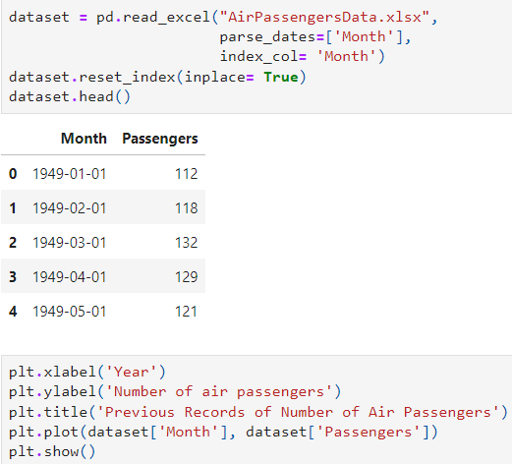
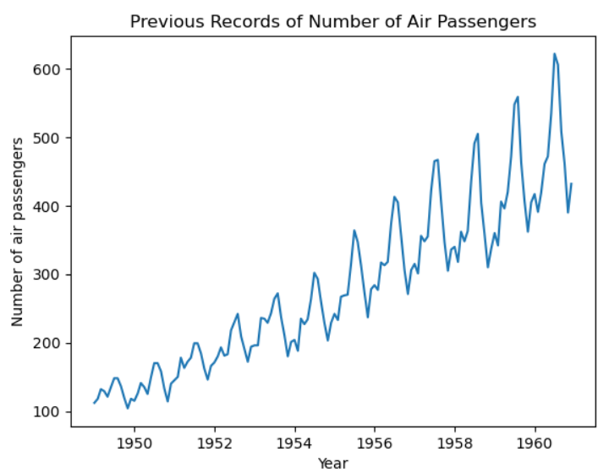
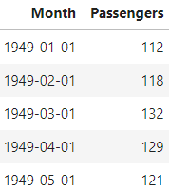
Perform Time Series Analysis using Python
Required Libraries:
Plotting Dataset:
Data Set:

Slide 7
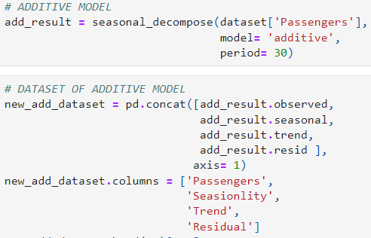
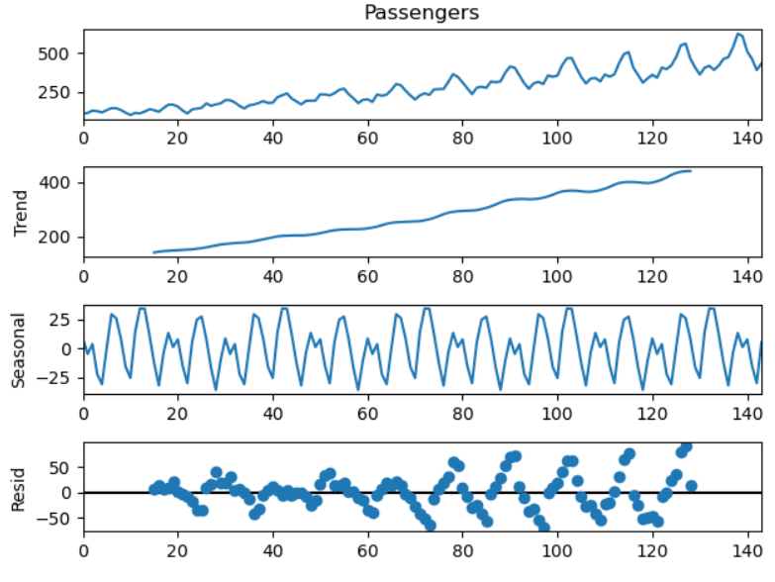
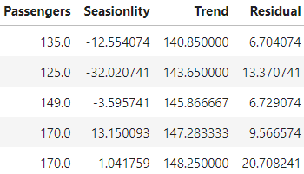
Additive Model

Slide 8
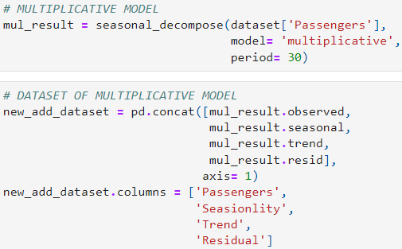
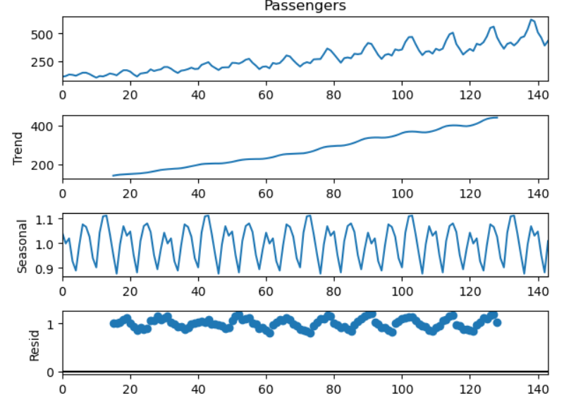
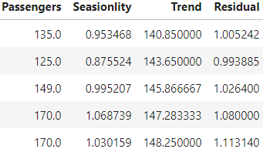
Multiplicative Model

Slide 9
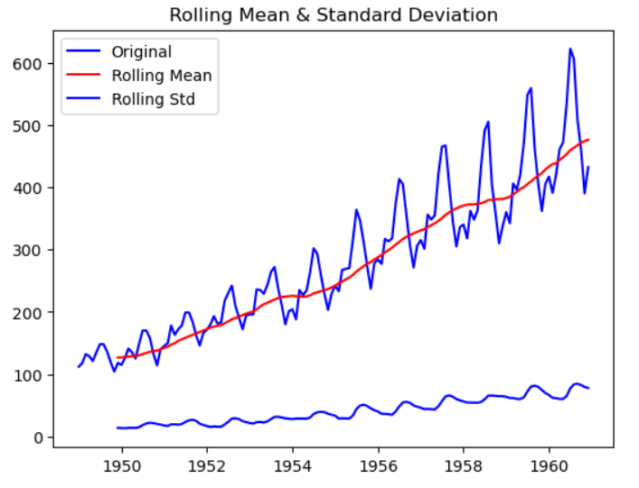

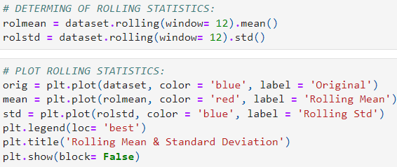
Determination of Trend using moving averages method
Code:

Slide 10
References:
Managerial Statistics - by S. Roychowdhury, D. Bhattacharya.
https://www.analyticsvidhya.com/blog/2021/10/a-comprehensive-guide-to-time-series-analysis/
https://github.com/Debsudu/Time-Series-CA-1

